Slide 1
BT201
Biochemical Process Calculations
11/08/2022

Slide 2

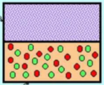


Multiphase system example: Extraction
Liquid-Liquid extraction is a mass transfer operation in which a liquid solution (the feed) is contacted with an immiscible or nearly immiscible liquid (solvent) that exhibits preferential affinity or selectivity towards one or more of the components in the feed.
Example:
To separate closed-boiling point mixture that cannot withstand high temperature of distillation
Example:
Recovery of penicillin from fermentation broth; solvent: butyl acetate.
Perfumes, fragrances and essential oils
Recovery of acetic acid from dilute aqueous solutions; solvent: ethyl-acetate.

Slide 3
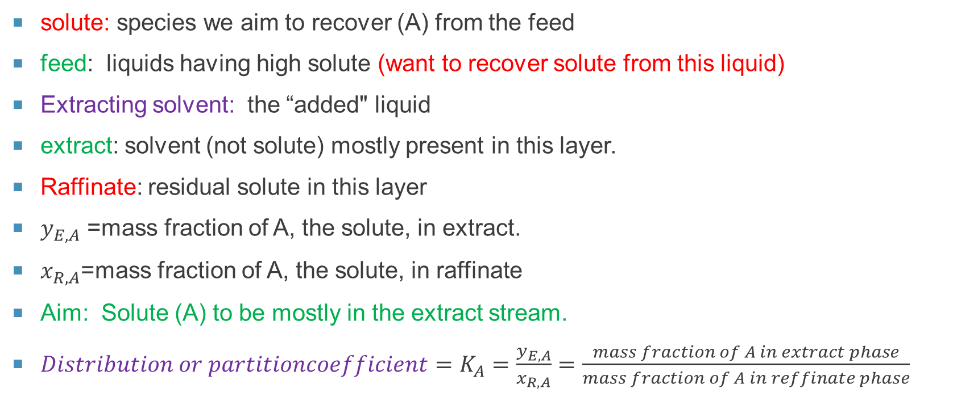


Co-current LIQUID-LIQUID extraction
Co-current LIQUID-LIQUID extraction
(solute (A) + liquid)
(residual low solute
in this layer)
$$x_{R,A}$$
(mostly solvent and solute (A)
present in this layer)
$$y_{E,A}$$
solute: species we aim to recover (A) from the feed
feed: liquids having high solute (want to recover solute from this liquid)
Extracting solvent: the “added" liquid
extract: solvent (not solute) mostly present in this layer.
Raffinate: residual solute in this layer
$y_{E,A}$ =mass fraction of A, the solute, in extract.
$x_{R,A}$=mass fraction of A, the solute, in raffinate
Aim: Solute (A) to be mostly in the extract stream.
$Distribution or partitioncoefficient=K_{A}=\frac{y_{E,A}}{x_{R,A}}=\frac{mass fraction of A in extract phase}{mass fraction of A in reffinate phase}$

Slide 4
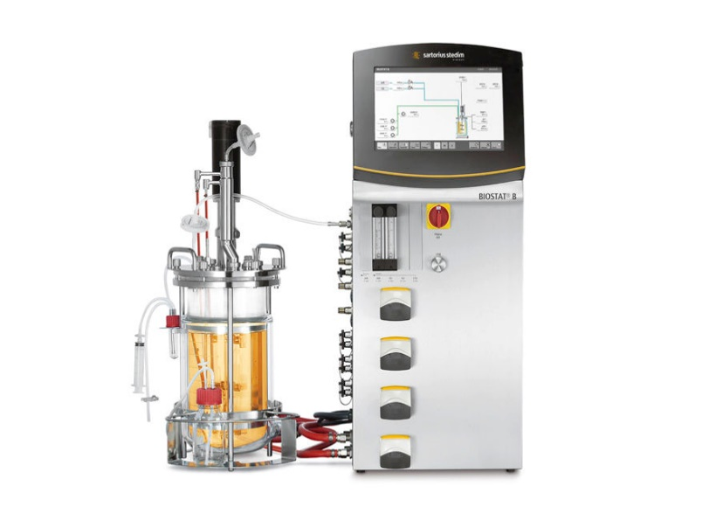
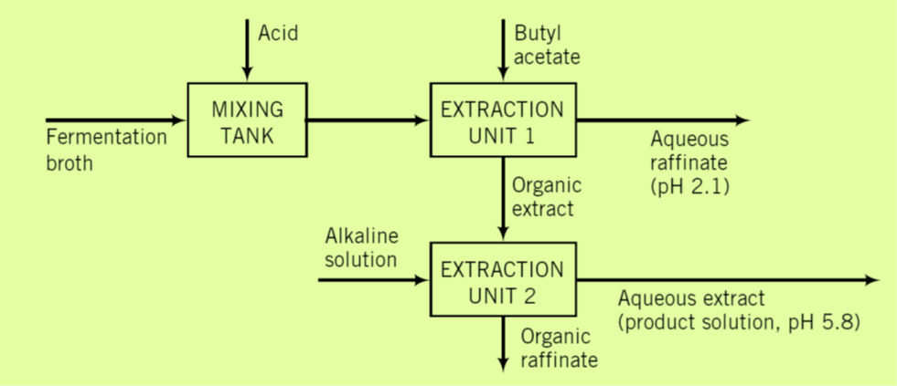
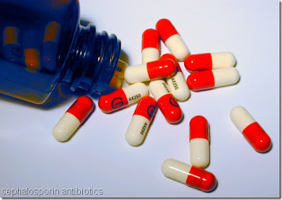
Antibiotic extraction
Filtration
(for cell
separation)
Penicillin,
Water,
Other chemical
(nutrients : C,N,P, Fe, ……

Slide 5
Streptomycin extraction
Streptomycin is used as an antibiotic to fight bacterial diseases in humans as well as to control
bacteria, fungi, and algae in crops. First an inoculate is prepared by placing spores of strains of
Streptomyces griseus in a medium to establish a culture with a high biomass. The culture is then
introduced into a fermentation tank which operates at 28°C and a pH of about 7.8 with the nutrients of glucose (the carbon source) and soybean meal (the nitrogen source). High agitation and aeration are needed.
After fermentation, the biomass is separated from the liquid, and Streptomycin is recovered by adsorption on activated charcoal followed by extraction with an organic solvent in a continuous extraction process. The extraction process is able to recover the Streptomycin because Streptomycin has a greater affinity for dissolving in the organic solution than in the aqueous solution.
In the extraction process 200 L/min of aqueous solution containing 10 g/l streptomycin is contacted by 10 L/min of organic solvent. The exit aqueous solution contains 0.2 g/L streptomycin. Determine the mass fraction of Streptomycin in the exit organic solvent assuming that no water exits with the solvent and no solvent exits with the aqueous solution. Assume that the density of the aqueous solution is 1.00 g/cm³ and the density of the organic solvent is 0.6 g/cm³. Ignore the details of the process and just consider the overall extraction process

Slide 6
200 L/min of aqueous solution containing 10 g/l streptomycin is contacted by 10 L/min of organic solvent. The exit aqueous solution contains 0.2 g/L streptomycin. Determine the mass fraction of Streptomycin in the exit organic solvent assuming that no water exits with the solvent and no solvent exits with the aqueous solution. Assume that the density of the aqueous solution is 1.00 g/cm³ and the density of the organic solvent is 0.6 g/cm³
10 L/min of organic solvent
streptomycin=0
200 L/min of aqueous solution
aqueous solution
10 g/l streptomycin
0.2 g/L streptomycin
organic solvent + extracted streptomycin (mass fraction??)

Slide 7
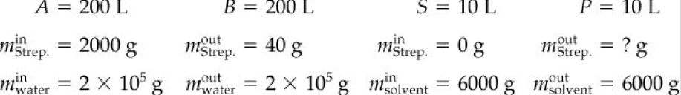
The degree-of-freedom analysis is as follows:
From an analysis of Fig, we can see that there is a total of eight variables for this problem
(i.e., four streams with two components in each stream).
You want to reduce the eight variables to as few unknowns as possible. the mass of a component is designated by m with appropriate superscripts and subscripts.
Let A and B denote the input and output aqueous streams, respectively, and S and P denote the input and output organic streams, respectively.
S
10 L/min
200 L/min
200 L/min
A
B
10 g/l streptomycin
0.2 g/l streptomycin
Number of unknowns: 1
Number of independent equations needed: 1
Note that we used one material balance for the water and one for the solvent in assigning values to variables.
What independent balance is left?
The material balance for the Streptomycin
P
10 L/min
Solvent 6000 g/l

Slide 8
10 L/min of organic solvent
streptomycin=0
200 L/min of aqueous solution
aqueous solution
10 g/l streptomycin
0.2 g/L streptomycin
organic solvent + extracted streptomycin (mass fraction??)
Streptomycin mass balance
Accumulation rate = rate of in - rate of out + rate of generation - rate of consumption
0= (200*10 +10*0) - (200*0.2 + 10*m) + 0 - 0
m=196 g/L of streptomycin in extracted organic solvent
I liter solvent= 0.6*1000=6000 g
Mass fraction = 196/(196+0.6*1000)=0.282

Slide 9
Absorption (scrubber)/ and desorption (stripper)
Food/ chemical/biotech industry
Liquid +
Low solute
Gas
+low solute
Absorption, a commonly used method for removing environmentally undesirable species from waste gases in chemical manufacturing and combustion processes.
The waste gas is contacted with a liquid solvent in which the potential pollutants are highly soluble and the other species in the waste gas are relatively insoluble.
Most of the pollutants go into solution and the cleaned gas is discharged to the atmosphere.
The liquid effluent may be discharged to a waste lagoon or subjected to further treatment to recover the solvent (desorption/stripping) and/or to convert the pollutant to a species that can be released safely to the environment
Absorption
Gas
+high solute
liquid
+high solute

Slide 10
Cont..
Carrier gas
liquid
Absorption/scrubbing: mass transfer operation in which one or more species (solute) is removed from a gaseous stream by dissolution in a liquid
mass transfer: solute transfer from gas to liquid
Carrier gas: solute free gas:
Gas stream: A and B.
Only A is transfer to liquid
B: carrier gas
Physical absorption/chemical absorption
solute
Carrier gas (B)
+ Solute (A)
Carrier liquid
+solute
Carrier gas
+solute
Carrier liquid
+solute
Desorption/Stripping: reverse of absorption. mass transfer operation in which one or more species (solute) is removed from liquid stream by a gas/steam
mass transfer: solute transfer from liquid to gas
solute
Carrier gas
Carrier liquid

Slide 11
Plate/stray/stage tower
Packed tower
Gas
+low
solute
Liquid +
low
solute
Gas
(air+low
CO₂/SO₂)
Liquid
(Water+ less or
no CO₂/SO₂)
The gas in the scrubber rises through a series of tray (metal plates perforated with many small holes),
and the solvent flows over the trays and through downcomers to the trays below. Gas bubbles emerge
from the holes in each tray and rise through the covering liquid, and SO diffuses out of the bubbles
G
L
Liquid
(Water+ high CO₂/SO₂)
Gas
+high
solute
liquid
+high
solute
Gas
Air+ high CO₂/SO₂

Slide 12
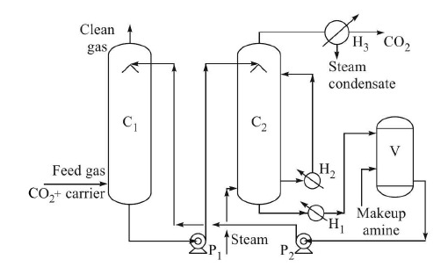
Example: Absorption/stripping
(use in urea plant)
Absorption
column
Stripping or regeneration column
(Synthesis gas)
(H₂, CO₂, CO)
Removal of CO₂ form synthesis gas (H₂, CO₂,CO) in ammonia plant
by Ethanol/methanol amine and stripping out of CO₂ by steam
*synthesis gas is produced from natural gas (CH₄, small amt. CO₂, H₂S). CO₂ negatively affects the iron catalyst used in the ammonia synthesis (3H₂+N₂→2NH₃).

